Slide 1


DATA SCIECEN
CAPSTONE PROJECT
PREDICTING THE LANDING
OF FALCON 9 OF SPACEX
By Zhuoquan Chen, October 2021

Slide 2

EXECUTIVE SUMMARY | INTRODUCTION | METHODOLOGY | RESULTS | CONCLUSION
IBM Data Science Capstone Project

Slide 3

EXECUTIVE SUMMARY
SUMMARY OF METHODOLOGIES
Data collection via APIs & web scraping
Data wrangling & Exploratory Data Analysis (EDA) & data visualization
Dynamic data visualization & analysis with Folium
Data Modeling with classification models
SUMMARY OF ALL RESULTS
Analysis with SQL
EDA
Interactive visual analytics
Predictive analysis
IBM Data Science Capstone Project

Slide 4

INTRODUCTION
PROJECT BACKGROUND
SpaceX advertised its Falcon 9 rocket launch at a cost of $62 million; Other companies cost more than $165 million. Unlike other rocket providers, SpaceX's Falcon 9 Can recover the first stage. Sometimes the first stage does not land. Sometimes it will crash. With most of the savings from first stage so if we can determine whether the first stage will land, we can determine the cost of the launch.
PROBLEMS I WANT TO FIND THE ANSWERS
What is the successful rate of landing?
Can weather affect the launch?
Which condition is the most important for success?
IBM Data Science Capstone Project

Slide 5

METHODOLOGY |
DATA COLLECTION | DATA WRANGLING | EDA | INTERACTIVE VISUAL ANALYTICS | MODELS
IBM Data Science Capstone Project

Slide 6
DATA COLLECTION
APIs
Using SpaceX APIs to access the data we need, then via Request library to return a json format text.
Code snippet
spacex_url = https://api.spacexdata.com/v4/launches/past
response = requests.get(spacex_url)
print(response.content)
[output] b'[{"fairings":{"reused":false,"recovery_attempt":false,"recovered":false,"ships":[]},"links":{"patch":{"small":"https://images2.imgbox.com/3c/0e/T8iJcSN3_o.png","large":"https://images2.imgbox.com/40/e3/GypSkayF_o.png"},"reddit":{"campaign":null,"launch":null,"media":null,"recovery":null},"flickr":{"small":[],"original":[]},"presskit":null,"webcast":"https://www.youtube.com/watch?v=0a_00nJ_Y88",”…
Then using these row data to transform to json format and product a data frame.
response = requests.get(static_json_url).json()
[output]
[{'fairings': {'reused': False, 'recovery_attempt': False, 'recovered': False, 'ships': []}, 'links': {'patch': {'small': 'https://images2.imgbox.com/3c/0e/T8iJcSN3_o.png', 'large': 'https://images2.imgbox.com/40/e3/GypSkayF_o.png'}, 'reddit': {'campaign': None, 'launch': None, 'media': None,…]
GitHub
IBM Data Science Capstone Project

Slide 7
DATA COLLECTION
Web Scraping
Scraping data from Wikipedia.
Code snippet
static_url = https://en.wikipedia.org/w/index.php?title=List_of_Falcon_9_and_Falcon_Heavy_launches&oldid=1027686922
response = requests.get(static_url).text
print(response)
[output]
<!DOCTYPE html> <html class="client-nojs" lang="en" dir="ltr"> <head> <meta charset="UTF-8"/> <title>List of Falcon 9 and Falcon Heavy launches - Wikipedia</title> <script>document.documentElement.className="client-js";RLCONF={"wgBreakFrames":!1,"wgSeparatorTransformTable":["",""],"wgDigitTransformTable":["",""],"wgDefaultDateFormat":"dmy","wgMonthNames":["","January","February","Marc…
# Use BeautifulSoup() to create a BeautifulSoup object from a response text content
soup = BeautifulSoup(response, 'html.parser’)
# Use the find_all function in the BeautifulSoup object, with element type `table`
html_tables = soup.find_all('table')
print(html_tables)
[output]
<table class="wikitable plainrowheaders collapsible" style="width: 100%;"> <tbody><tr> <th scope="col">Flight No. </th> <th scope="col">Date and<br/>time (<a href="/wiki/Coordinated_Universal_Time" title="Coordinated Universal Time">UTC</a>) </th>…
GitHub
IBM Data Science Capstone Project

Slide 8
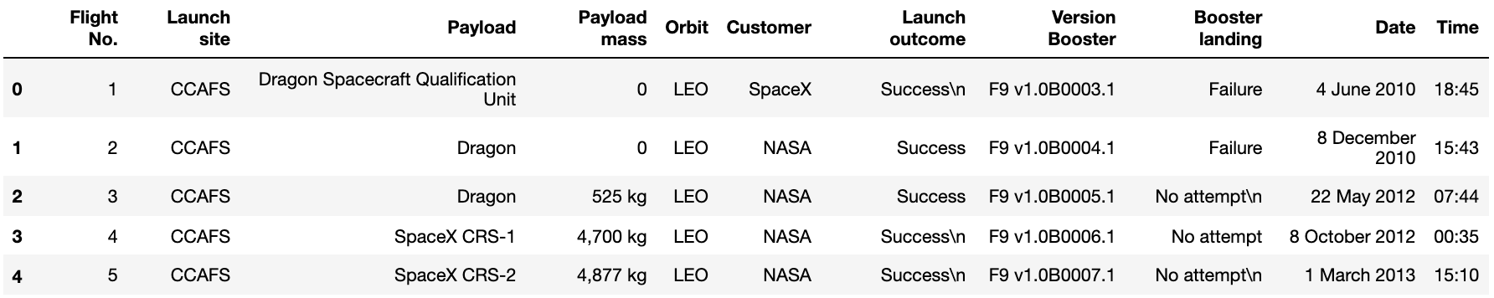
DATA COLLECTION
IBM Data Science Capstone Project

Slide 9
DATA WRANGLING
The process of cleaning, organizing, and unifying raw, complex, unorganized data sets so that they are more accessible for future data analysis.
landing_class = df['Outcome'].apply(lambda x : 0 if x in bad_outcomes else 1)
landing_class
[output]
0 0
1 0
2 0
3 0
4 0
df['LaunchSite'].value_counts()
[output]
CCAFS SLC 40 55
KSC LC 39A 22
VAFB SLC 4E 13
The Number Of
Launches
on each site
The Number and occurrence of mission outcome per orbit type
1
2
3
4
df['LaunchSite'].value_counts()
[output]
CCAFS SLC 40 55
KSC LC 39A 22
VAFB SLC 4E 13
The number and occurrence of each orbit
landing_outcomes = df['Outcome'].value_counts()
landing_outcomes
[output]
True ASDS 41
None None 19
True RTLS 14
False ASDS 6
True Ocean 5
None ASDS 2
False Ocean 2
False RTLS 1
Create a landing outcome label from Outcome column
IBM Data Science Capstone Project

Slide 10
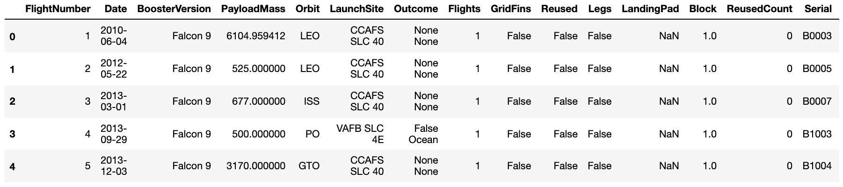
DATA WRANGLING
GitHub
IBM Data Science Capstone Project

Slide 11
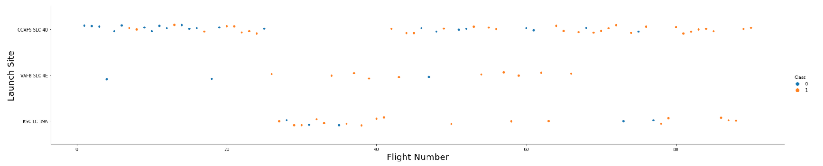
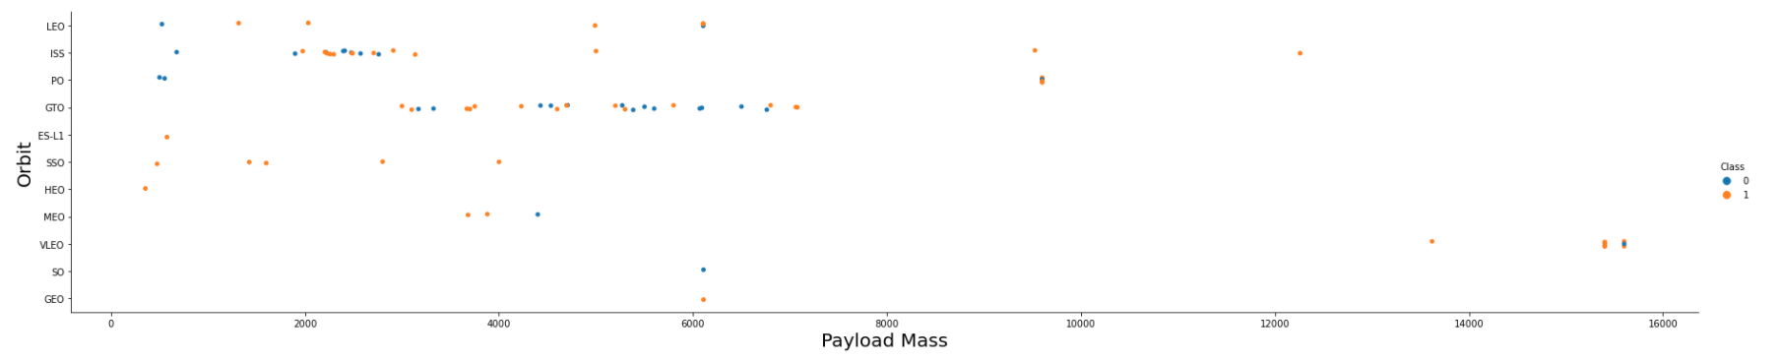
EDA WITH DATA VISUALIZATION
Visualize the relationship between Flight Number and Launch Site
Visualize the relationship between Payload and Orbit type
GitHub
IBM Data Science Capstone Project

Slide 12
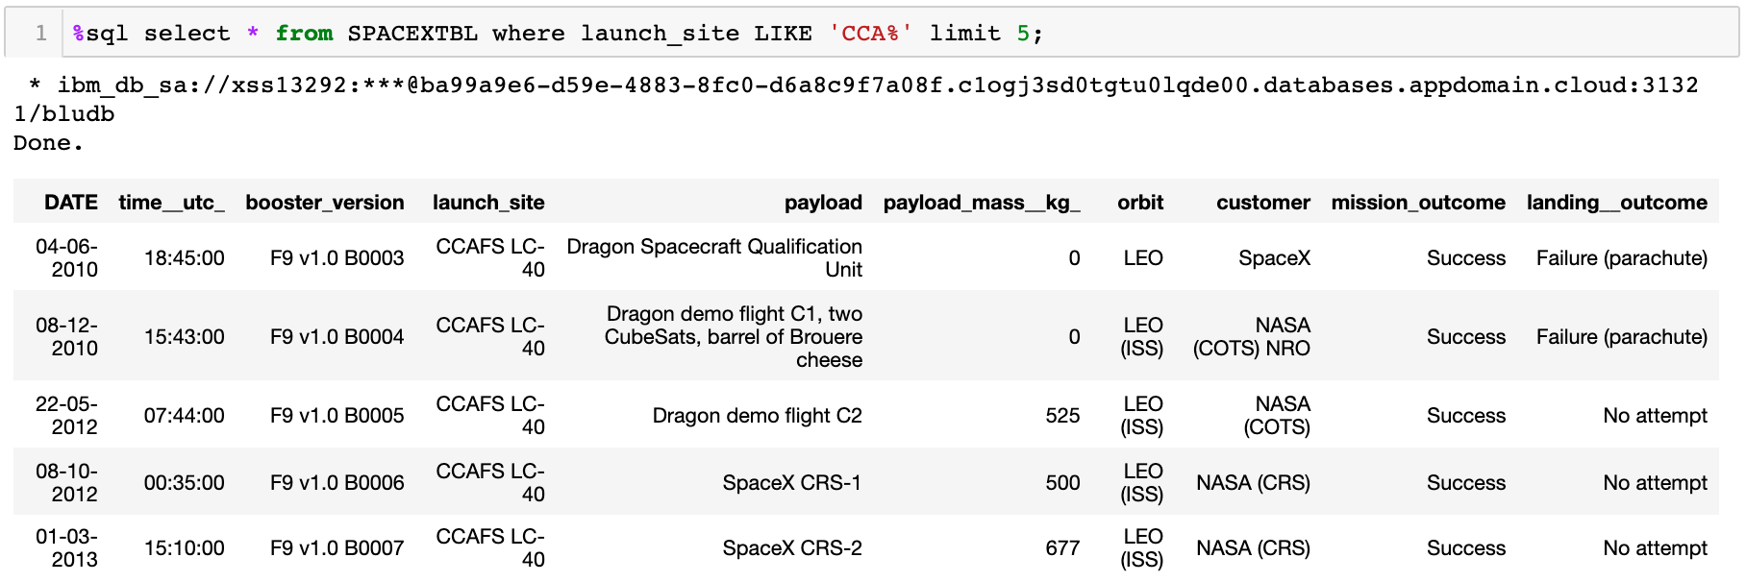
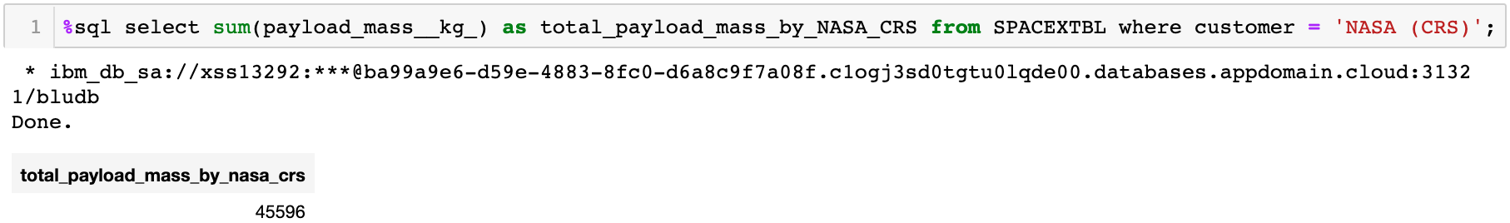
EDA WITH DATA VISUALIZATION
Where launch sites begin with the string 'CCA'
Visualize the relationship between Payload and Orbit type
The total payload mass carried by boosters launched by NASA (CRS)
GitHub
IBM Data Science Capstone Project

Slide 13
BUILD AN INTERACTIVE MAP WITH FOLIUM
Where launch sites begin with the string 'CCA'
Visualize the relationship between Payload and Orbit type
The total payload mass carried by boosters launched by NASA (CRS)
GitHub
IBM Data Science Capstone Project

Slide 14
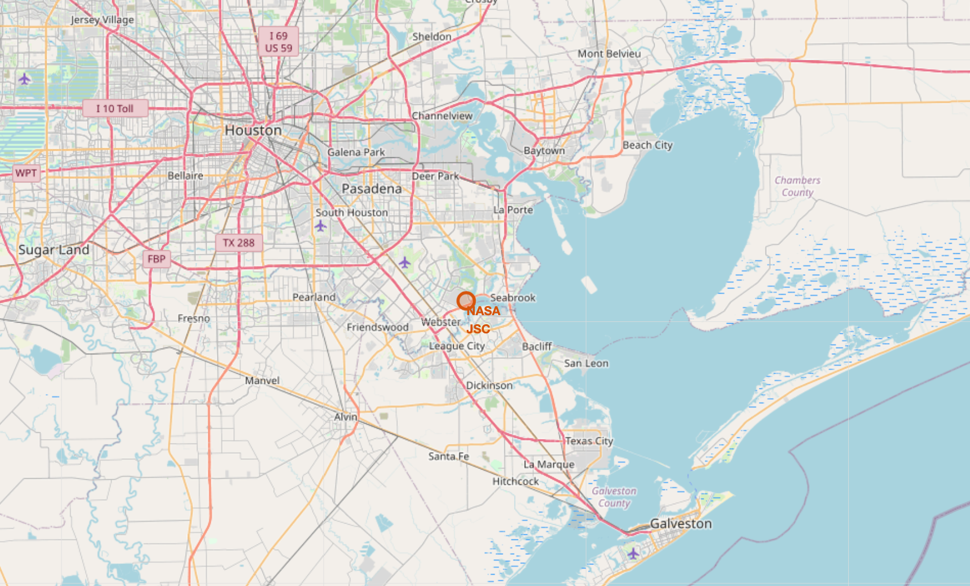
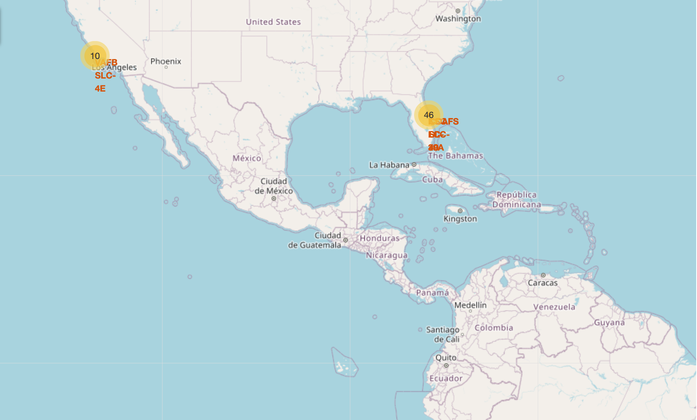
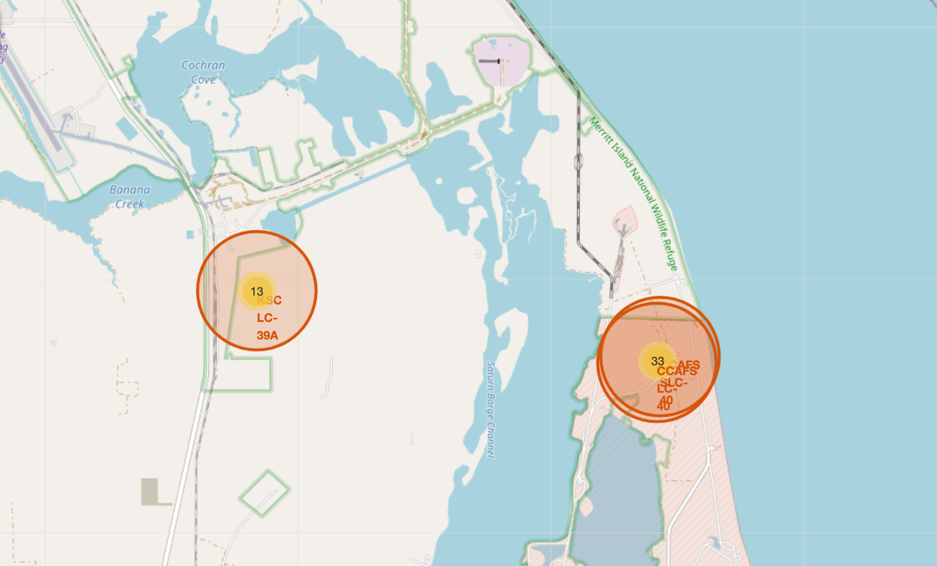
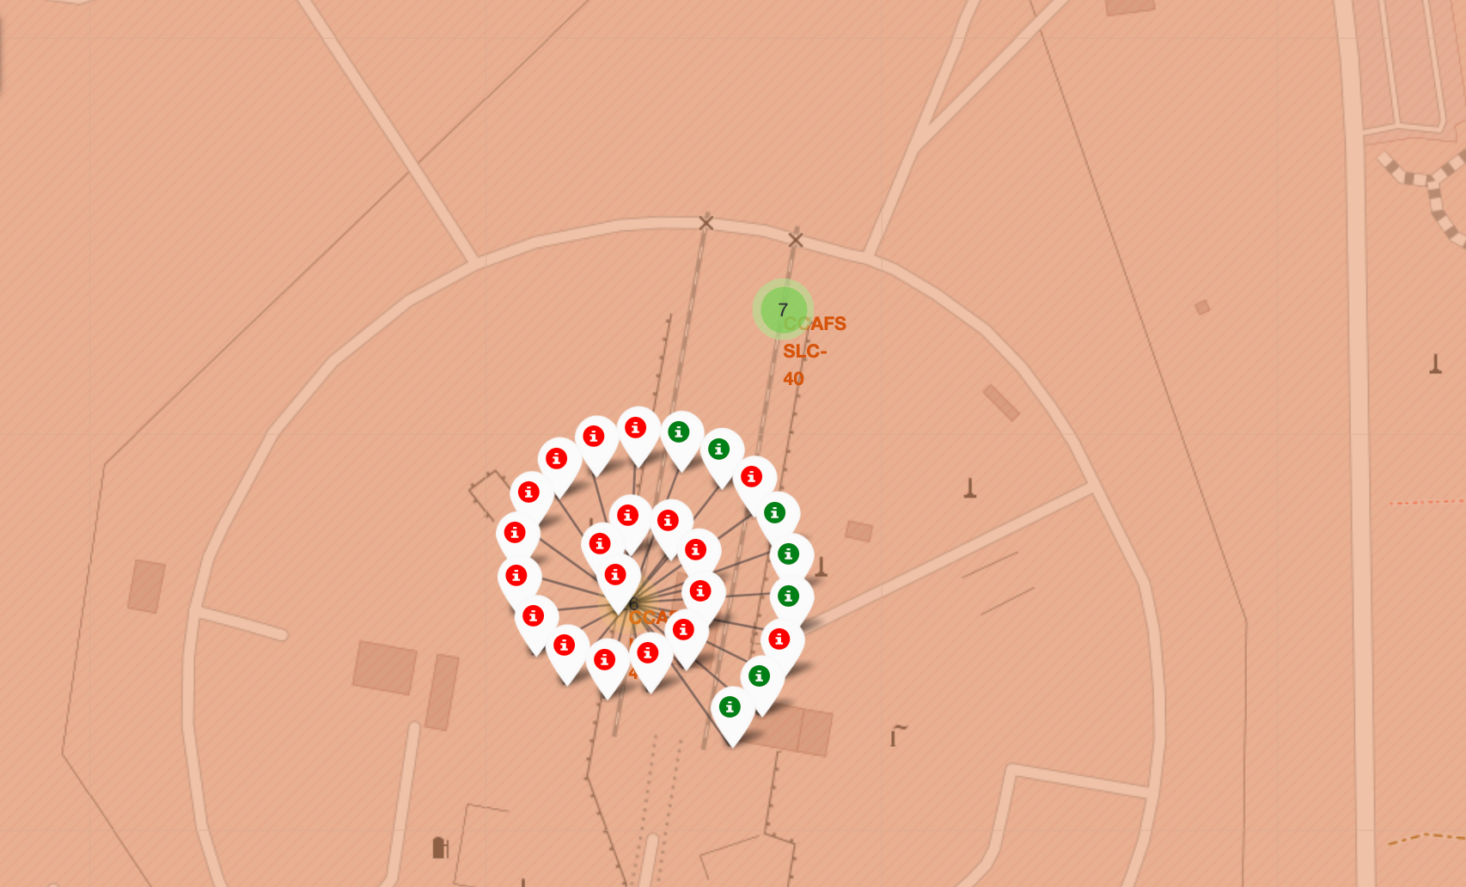
BUILD AN INTERACTIVE MAP WITH FOLIUM
an initial center location to be NASA Johnson Space Center at Houston, Texas.
Mark all launch sites on a map
The number of the launches of each launch site
Mark the success/failed launches for each site on the map
GitHub
IBM Data Science Capstone Project

Slide 15

PREDICTIVE ANALYSIS (CLASSIFICATION)
Create a GridSearchCV object for search an optimal value of parameters
Standardize the scale of all numeric type data
1
2
3
4
Split the dataset into X_train, X_test, Y_train, Y_test
Create a confusing matrix for checking performance of the model
GitHub
IBM Data Science Capstone Project

Slide 16
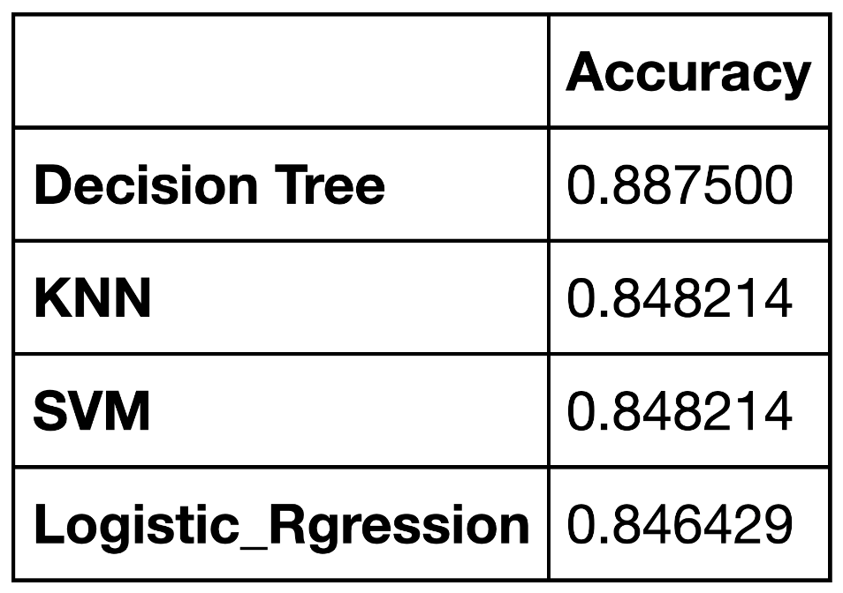
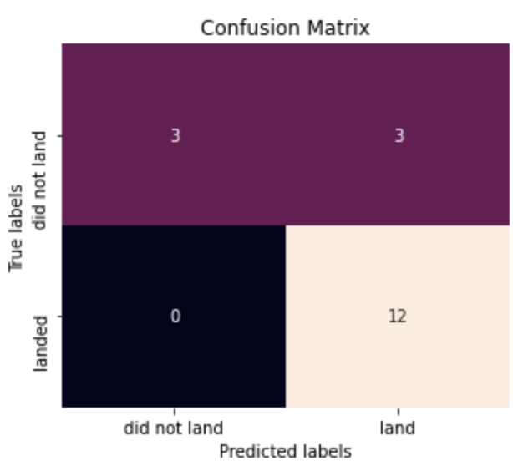



RESULTS
IBM Data Science Capstone Project

Slide 17

IISIGHTS DRAWN
FROM EDA
IBM Data Science Capstone Project

Slide 18
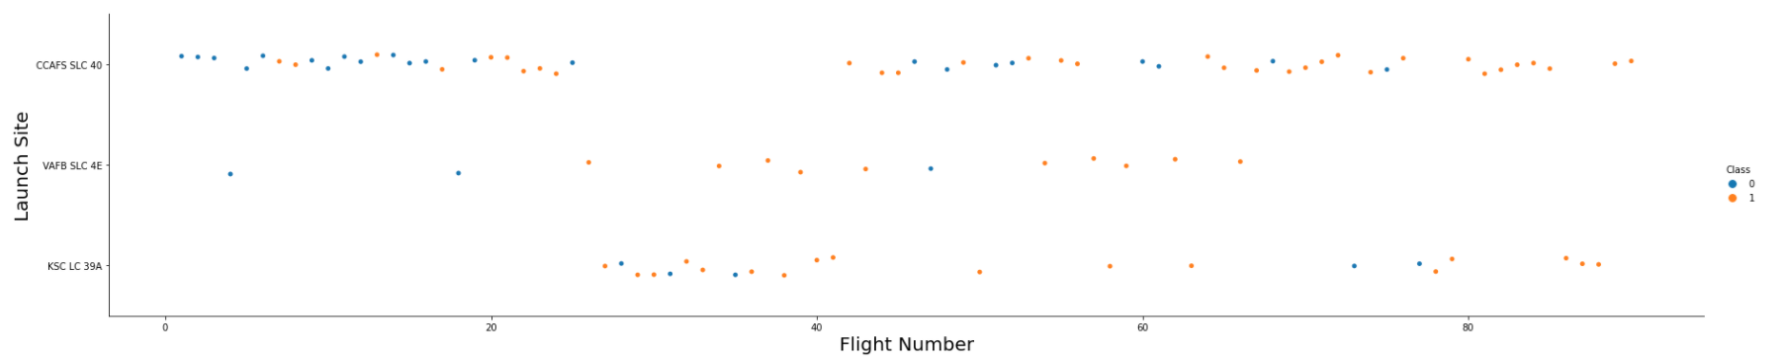
FLIGHT NUMBER vs. LAUNCH SITE
Different launch sites have different success rates. CCAFS LC-40, has a success rate of 60 %, while KSC LC-39A and VAFB SLC 4E has a success rate of 77%.
IBM Data Science Capstone Project

Slide 19
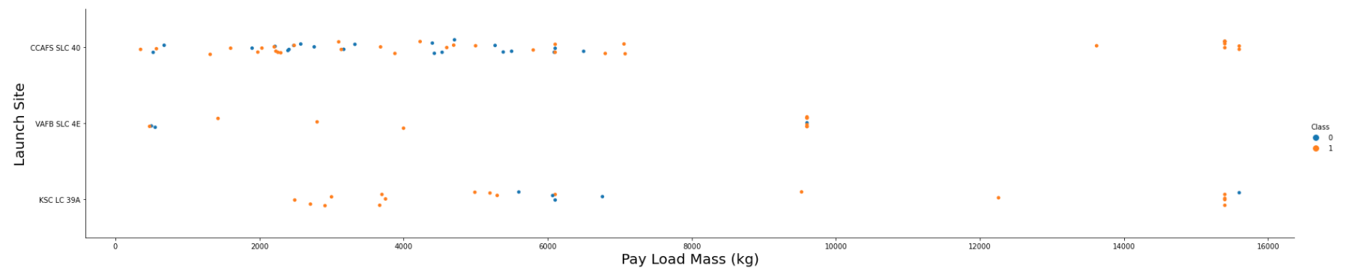
PAYLOAD vs. LAUNCH SITE
The VAFB-SLC launch site there are no rockets launched for heavy payload mass
(greater than 10000).
IBM Data Science Capstone Project

Slide 20
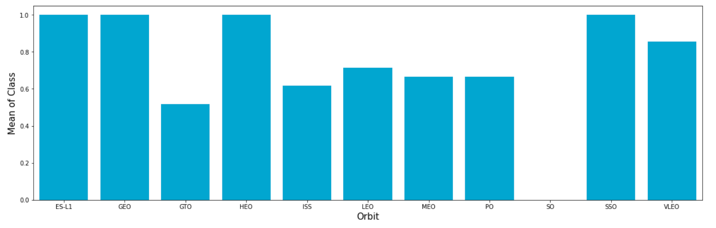
PAYLOAD vs. LAUNCH SITE
Success rate of each orbit type of SO was 0.
IBM Data Science Capstone Project

Slide 21
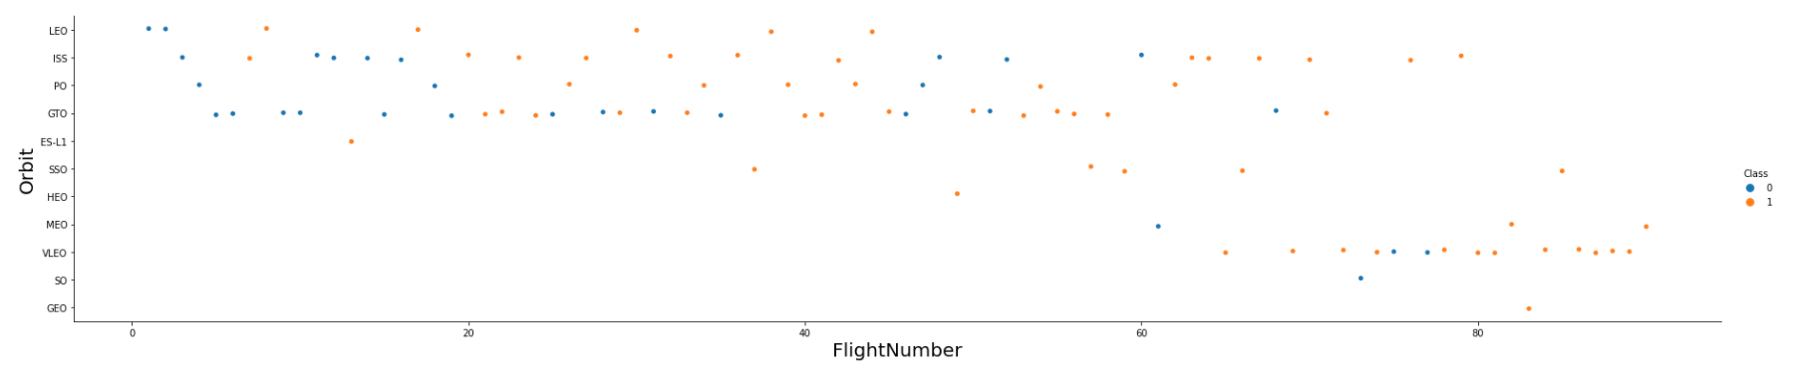
FLIGHT NUMBER vs. ORBIT TYPE
In the LEO orbit the success appears related to the number of flights; on the other hand, there seems to be no relationship between flight number when in GTO orbit.
IBM Data Science Capstone Project

Slide 22
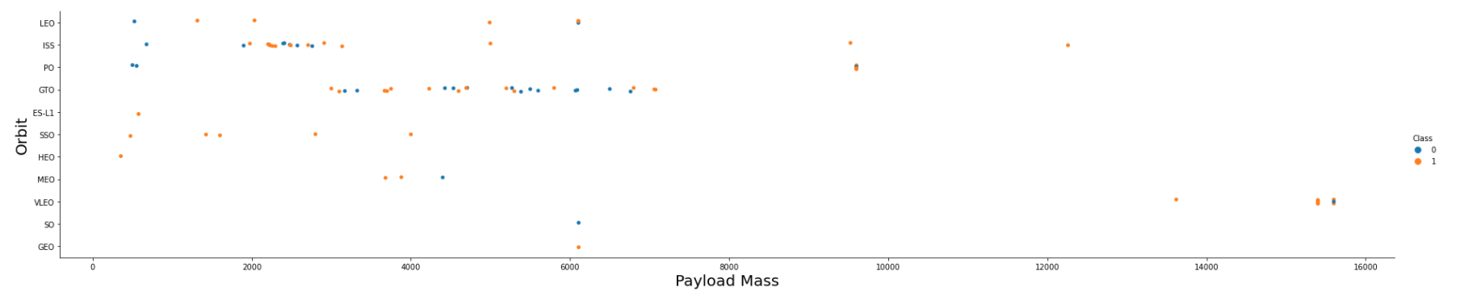
PAYLOAD vs. ORBIT TYPE
In the LEO orbit the success appears related to the number of flights; on the other hand, there seems to be no relationship between flight number when in GTO orbit.
IBM Data Science Capstone Project

Slide 23
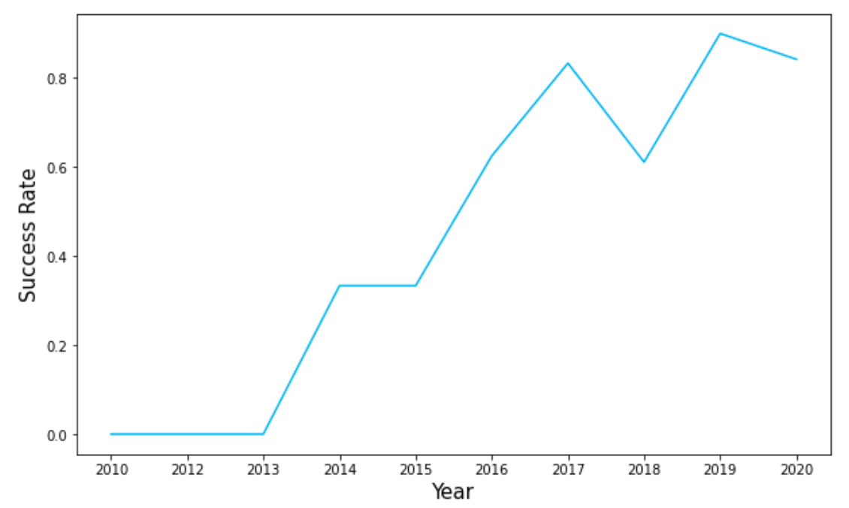
LAUNCH SUCCESS YEARLY TREND
The success rate since 2013 kept increasing till 2020
IBM Data Science Capstone Project

Slide 24

LAUNCH SITES PROXIMITIES ANALYSIS
IBM Data Science Capstone Project

Slide 25
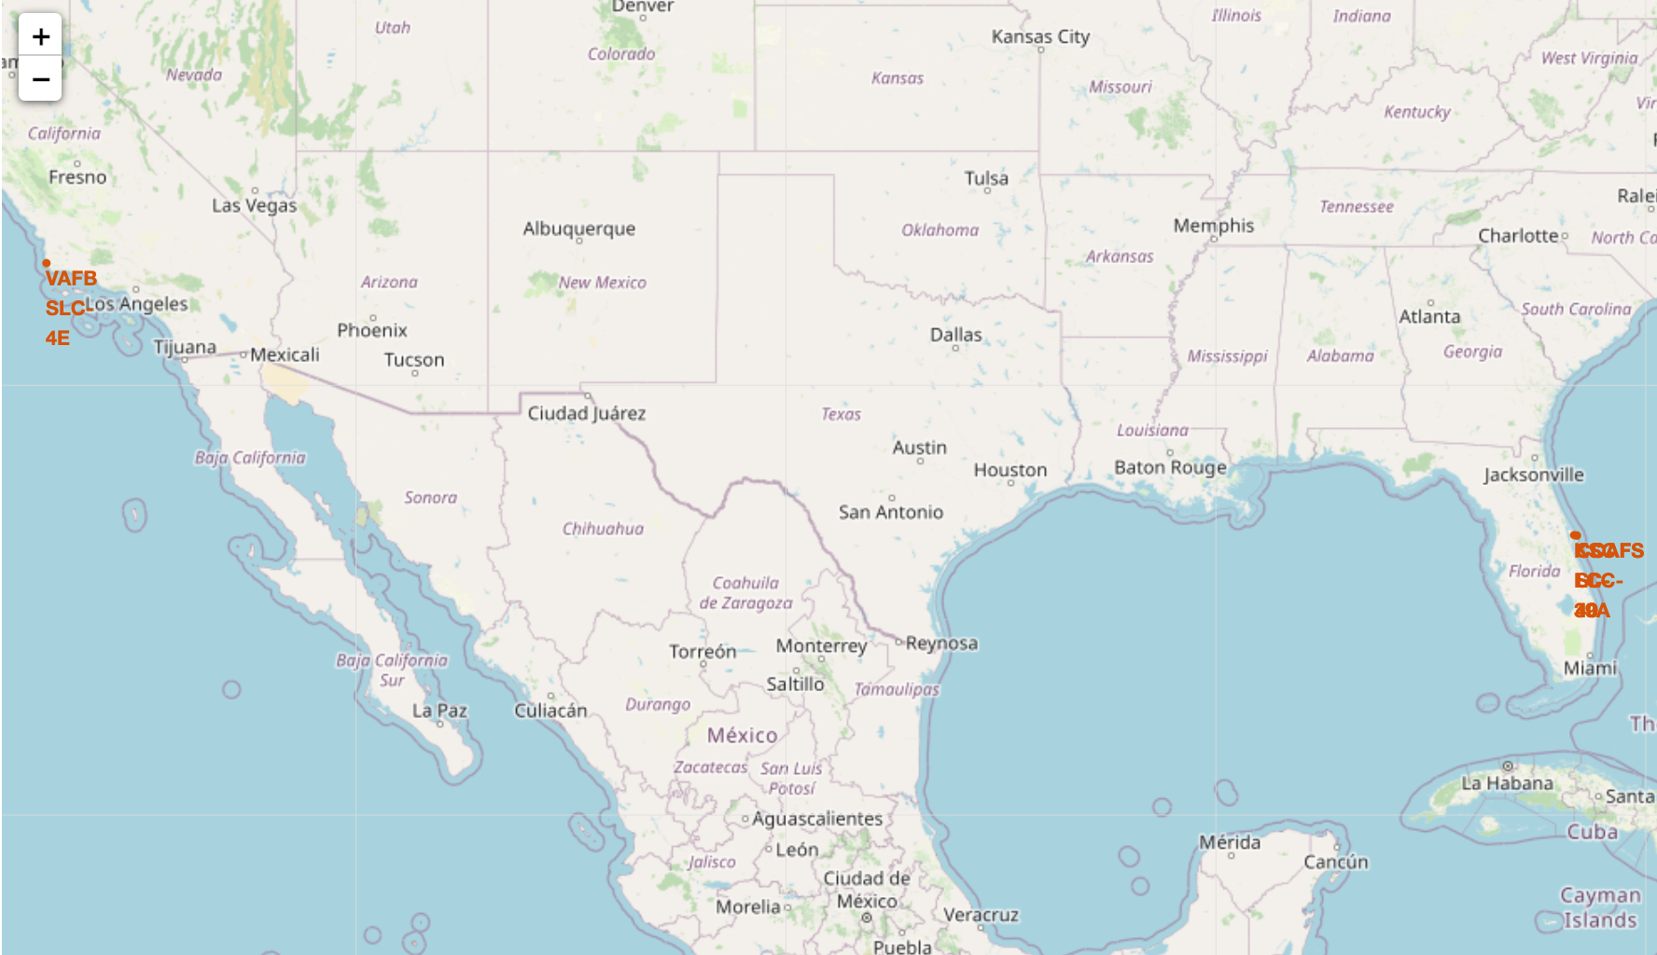
LAUNCH SITE LOCATIONS
All of launch sites are closed coasts of the United States.
IBM Data Science Capstone Project

Slide 26
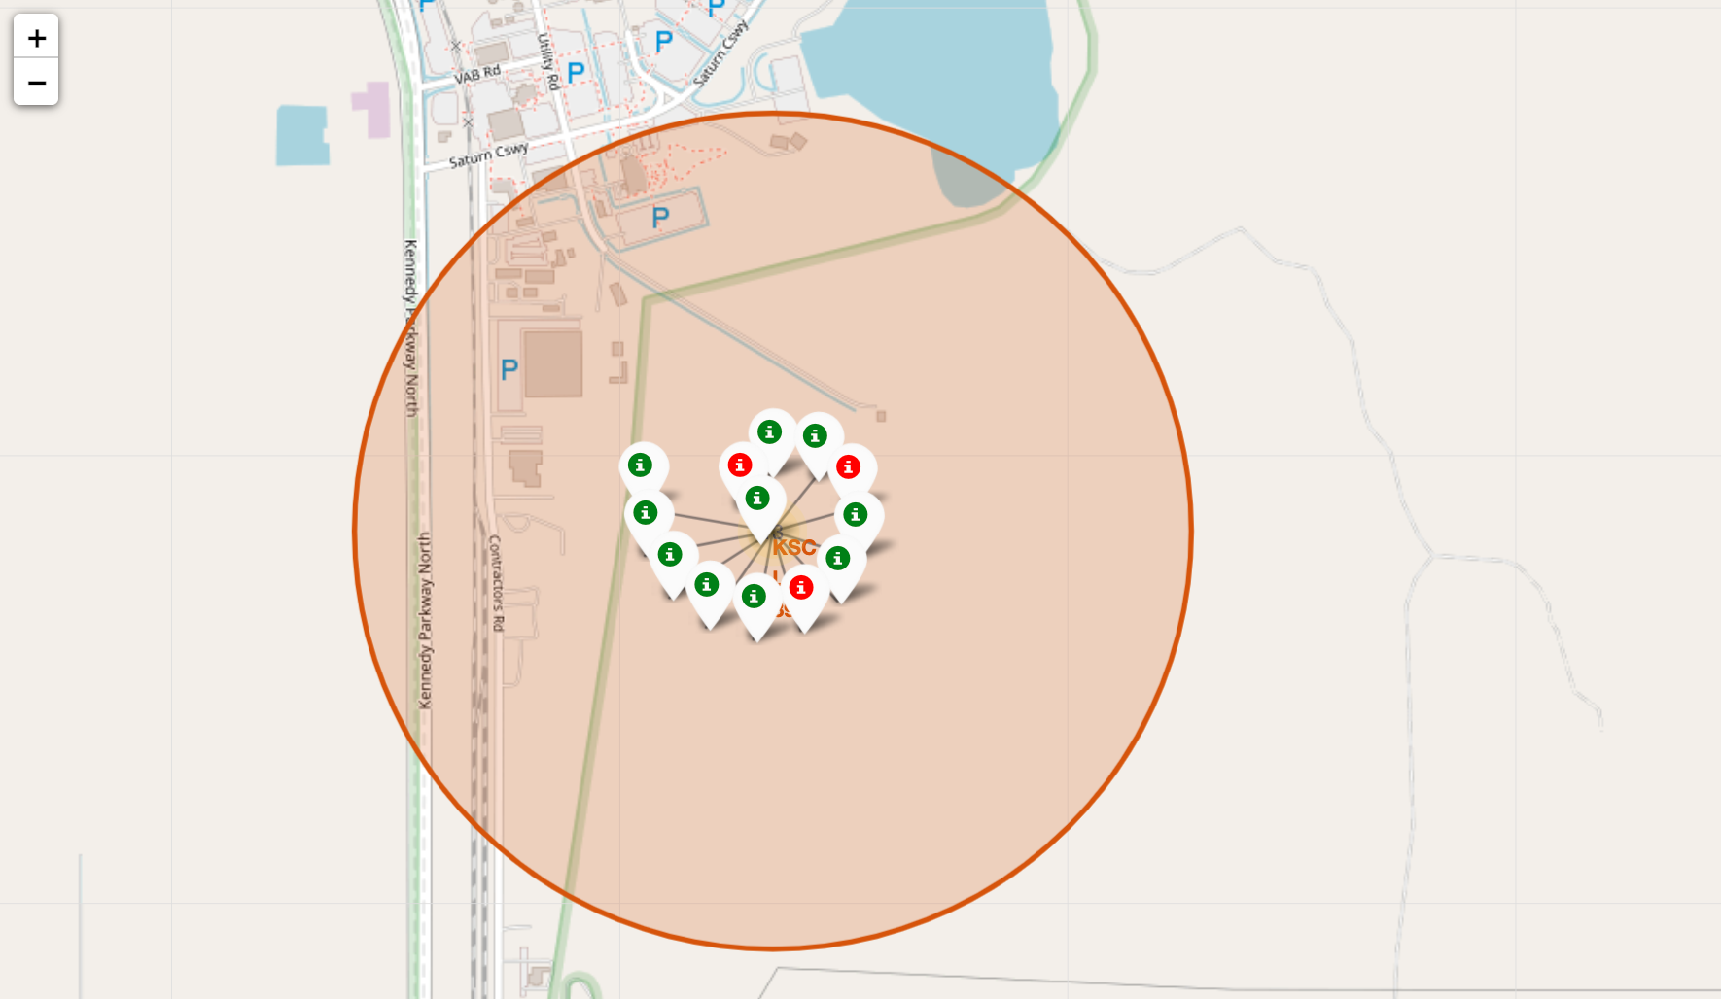
LAUNCH SITE LABELS
The green markers represent the successful launches, and the red markers represent the fail launches.
IBM Data Science Capstone Project

Slide 27
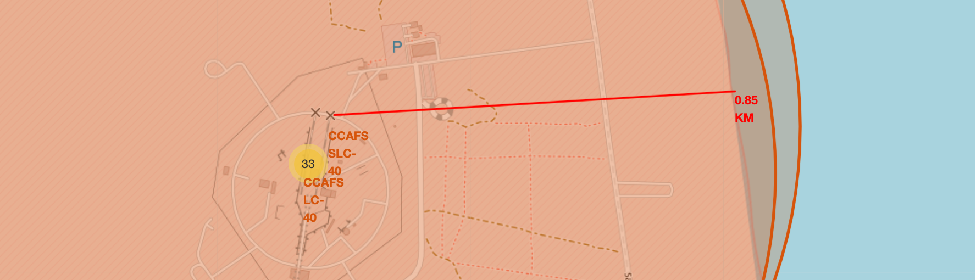
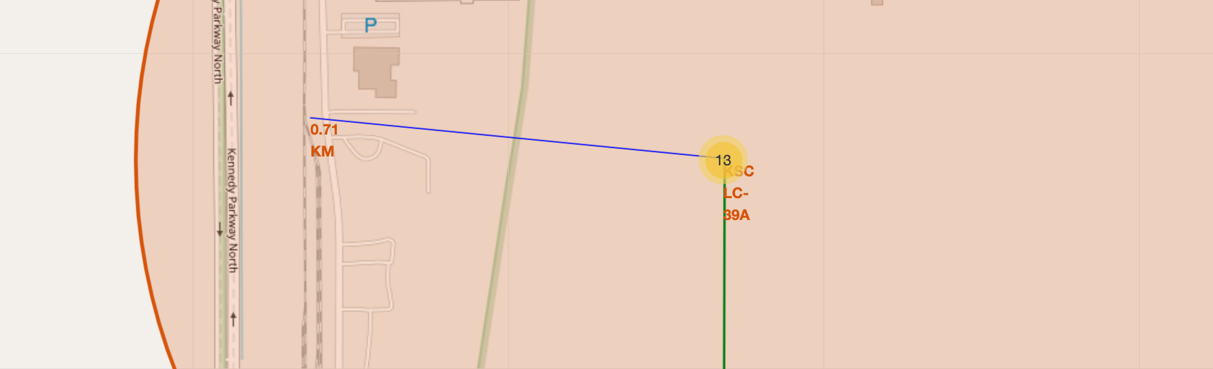
THE DISTANCES BETWEEN LAUNCH SITES AND OTHER PLACES
Show the distances between CCAFS SLC 40 and coast, KSC LC 39A and highways. etc.
IBM Data Science Capstone Project

Slide 28

PREDICTIVE ANALYTICS
(CLASSIFICATION)
IBM Data Science Capstone Project

Slide 29
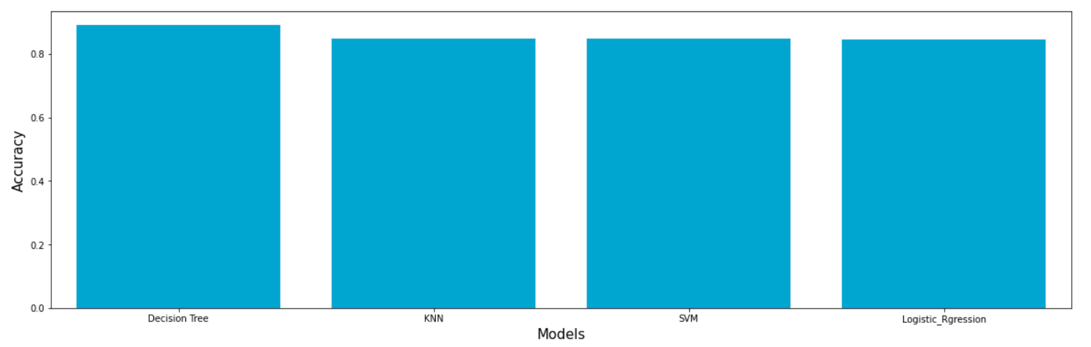
CLASSIFICATION ACCURACY
IBM Data Science Capstone Project

Slide 30
CONFUSION MATRIXS
Logistic Regression
SAM
All models’ performance are same in this project:
Sensitivity: TP / (TP + FN) = 12 / (12 + 0) = 100%
Specificity: TN / (TN + FP) = 3 / (3 + 3) = 50%
Precision: TP / (TP + FP) = 12 / (12 + 3) = 80%
Accuracy: (TP + TN) / (TP + TN + FP + FN)
= (12 + 3) / (12 + 3 + 3 + 0) = 83.33%
Decision Tree
KNN
IBM Data Science Capstone Project

Slide 31
CONCLUSION
Overview the project:
different launch sites have different success rates. CCAFS LC-40, has a success rate of 60 %, while KSC LC-39A and VAFB SLC 4E has a success rate of 77%.
the VAFB-SLC launchsite there are no rockets launched for heavypayload mass(greater than 10000).
in the LEO orbit the Success appears related to the number of flights; on the other hand, there seems to be no relationship between flight number when in GTO orbit.
Orbits ES-L1, DEO, HEO, and SSO had highest successful rate.
KSC LC-39A had the best successful launches, but with increasing payload mass it seems to have negative impact on success.
the success rate since 2013 kept increasing till 2020.
Decision tree model has a best performance.
IBM Data Science Capstone Project

Slide 32

THANK
YOU!
IBM Data Science Capstone Project

